Slide 1
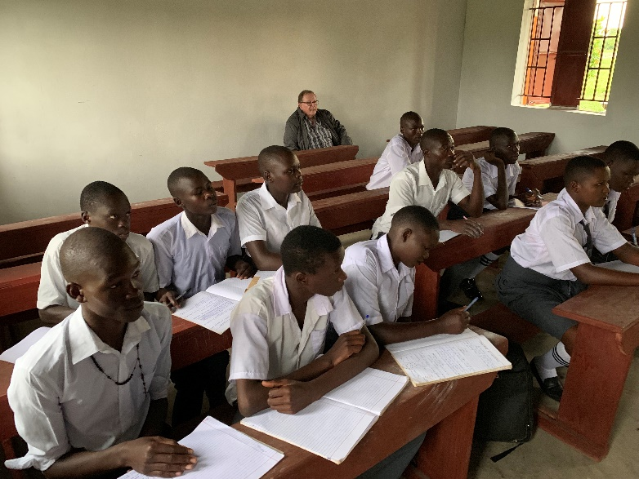
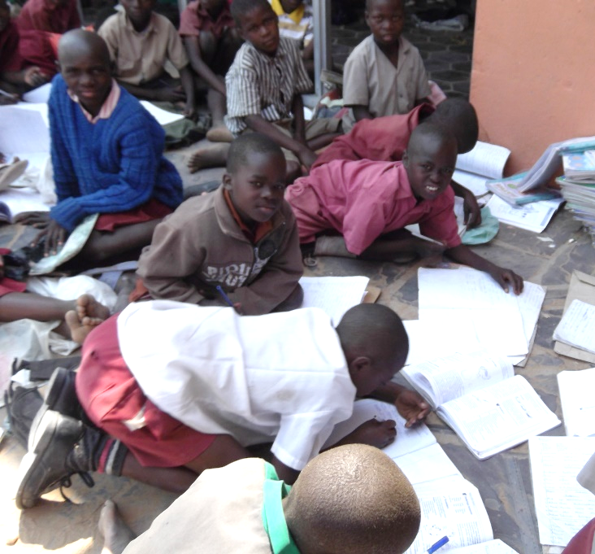
Classrooms for Africa
Desk Project 2020
DESKS
NEEDED!

Slide 2
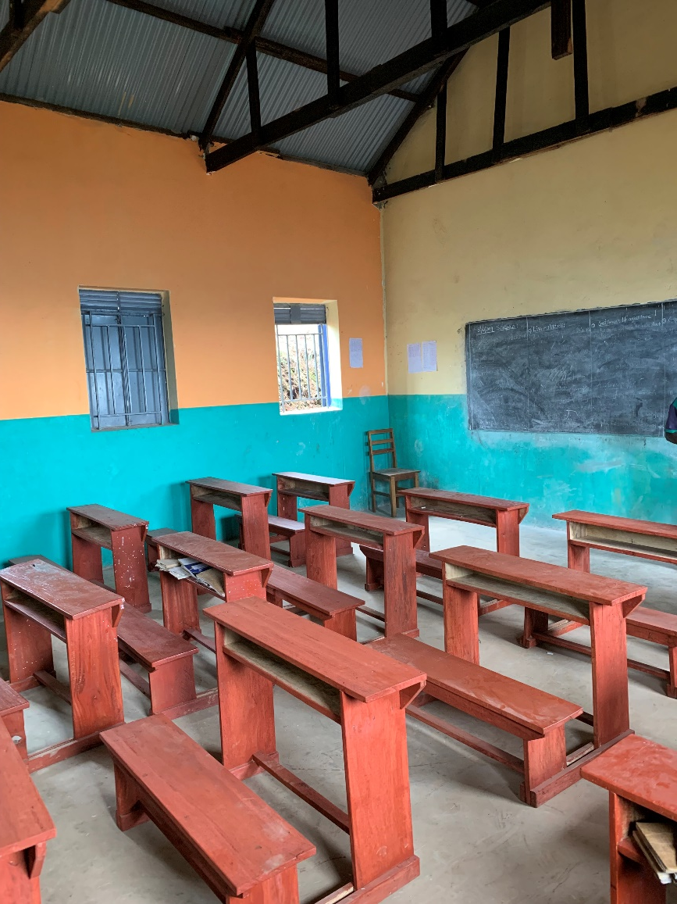
$20 will provide
a workspace for
a needy student
in Africa

Slide 3
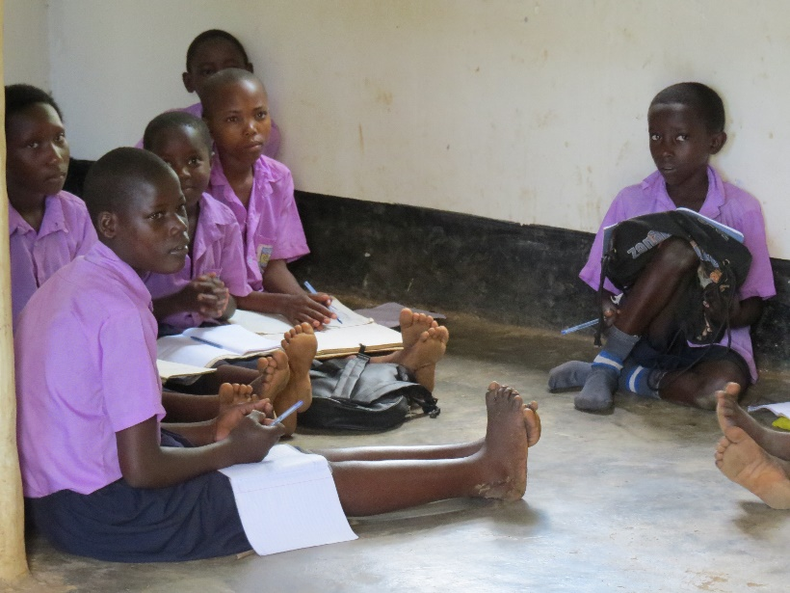
What is problem?
Classrooms for Africa builds over 25 classrooms each year in needy schools in Africa
Many students still sit and write on the ground because they have no desks!

Slide 4
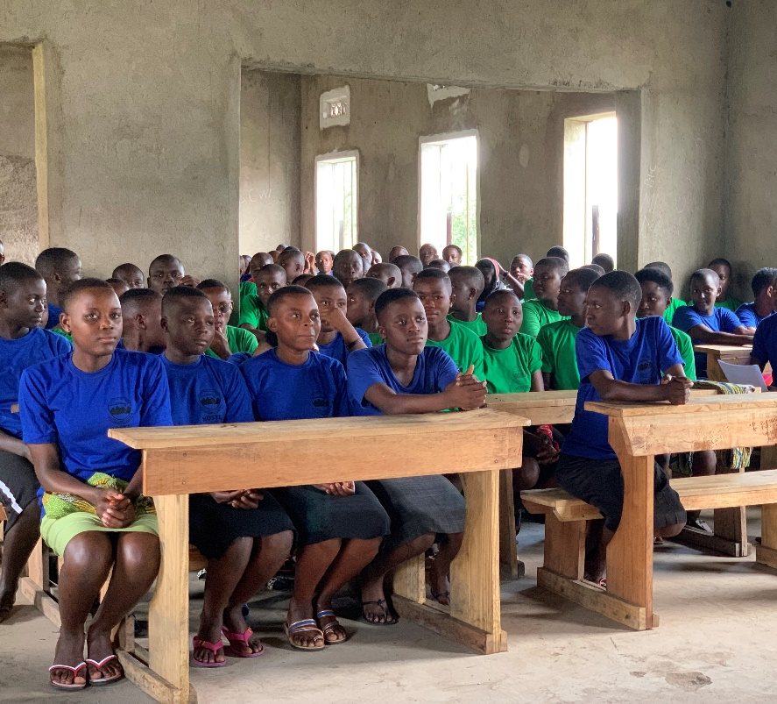
What is the goal?
To provide 2000 students
with desks this school year

Slide 5
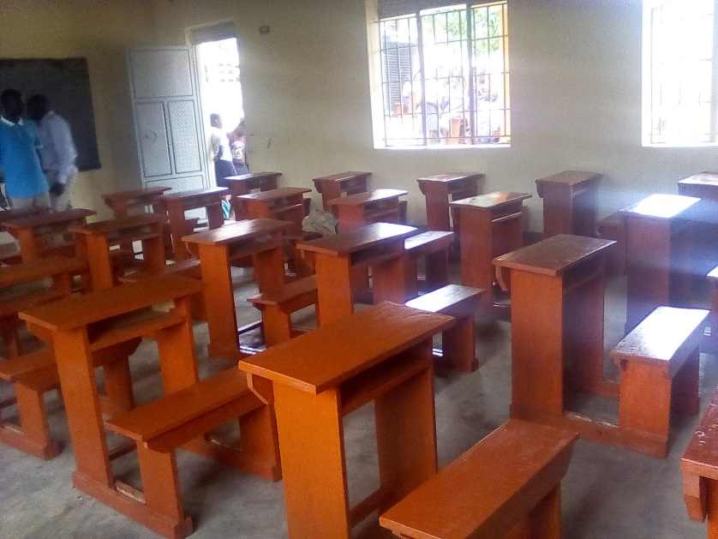
What is the cost?
$20 for seating for one student
$800 for a classroom
of 40 students including teacher table and chair

Slide 6
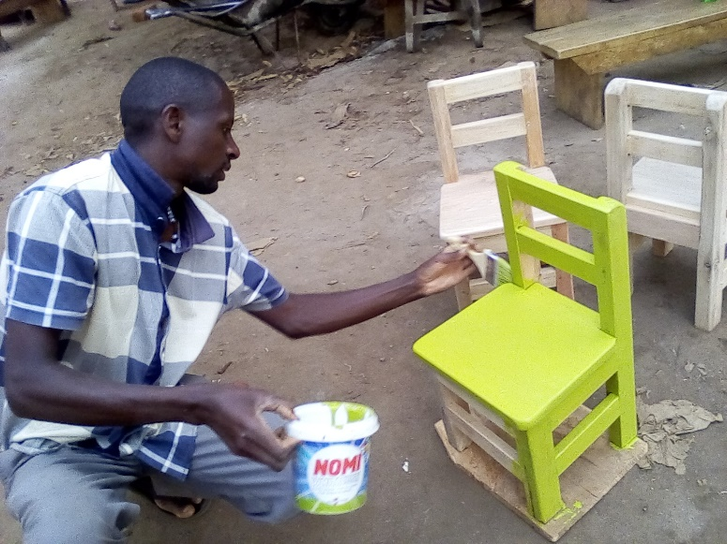
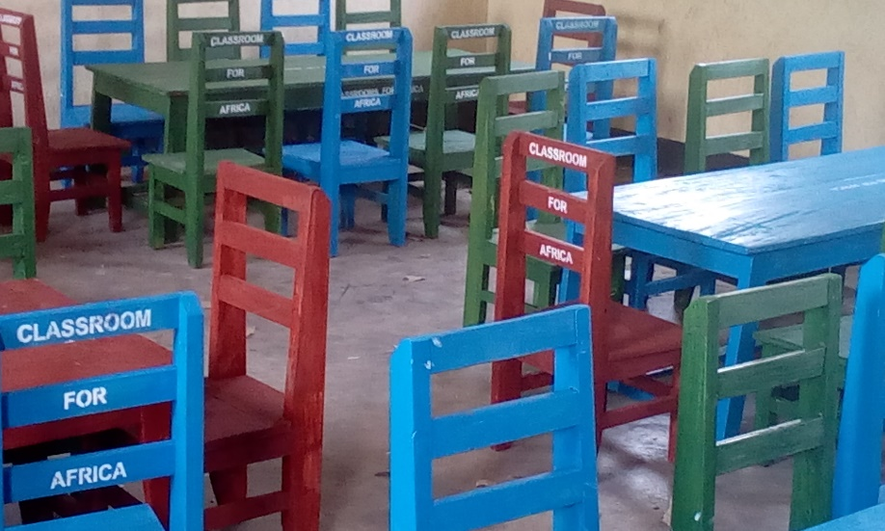
Ready to help?
Donations can be made either
By mail to:
P. O. Box 74006 Fraser Heights
Surrey, BC
V4N 5H9
OR
Online at
www.classroomsforafrica.org
Click on the “Desks Project” button on main page, then click on the “Give Now” button. Choose Classrooms Africa Desks option on the Canada Helps page

Slide 7
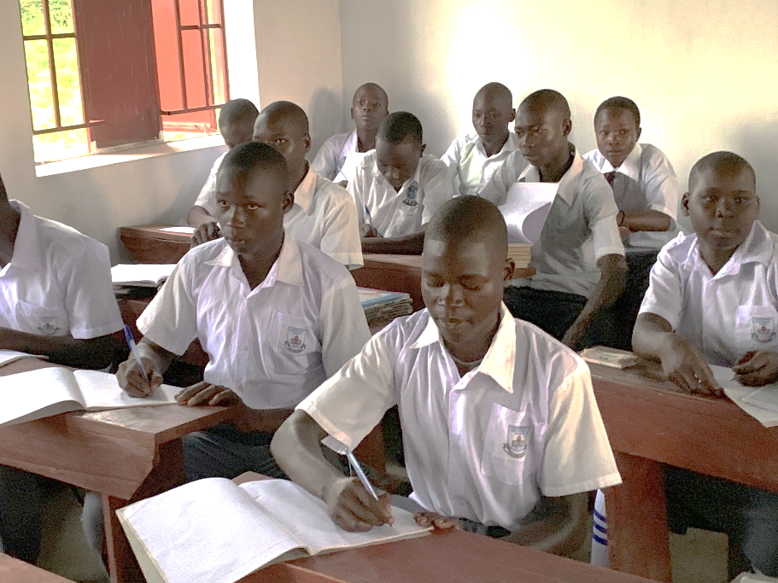
Thank you
for partnering with Classrooms for Africa
in this effort to help the students in Africa!
www.classroomsforafrica.org

